Slide 1
DISTRIBUTED SYSTEMS
Principles and Paradigms
Second Edition
ANDREW S. TANENBAUM
MAARTEN VAN STEEN
Chapter 2
ARCHITECTURES

Slide 2
Architectural Styles (1)
Important styles of architecture for distributed systems
Layered architectures
Object-based architectures
Data-centered architectures
Event-based architectures

Slide 3
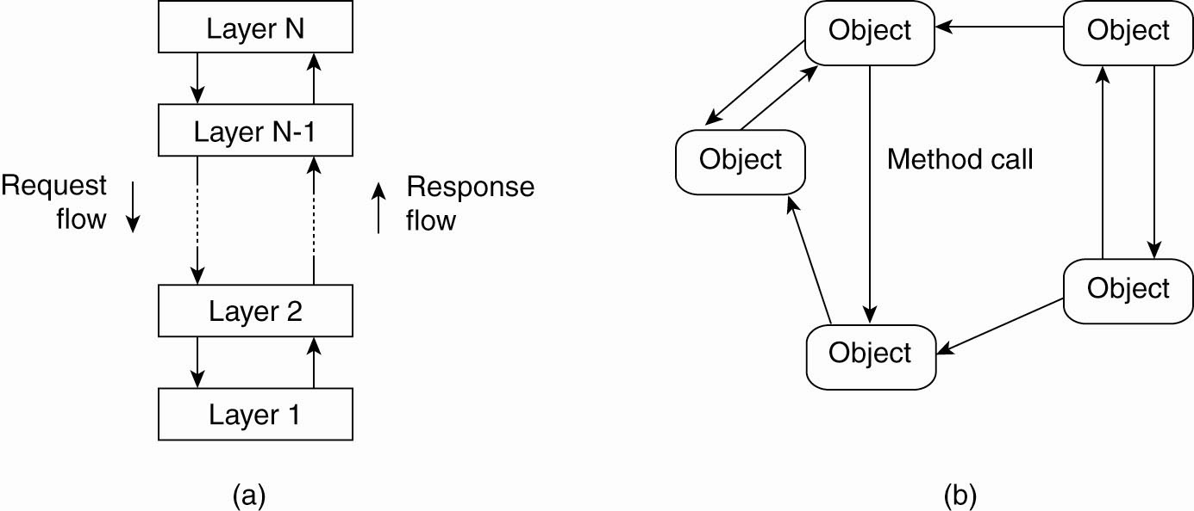
Architectural Styles (2)
Figure 2-1. The (a) layered architectural style and …

Slide 4
Architectural Styles (3)
Figure 2-1. (b) The object-based architectural style.

Slide 5
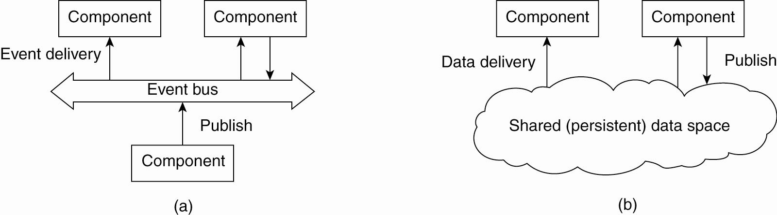
Architectural Styles (4)
Communication via propagation of events
Mostly Publish/Subscribe
E.g. register interest in market info
Figure 2-2. (a) The event-based architectural style and …

Slide 6
Architectural Styles (5)
Data Centric Architecture
E.g. Share distributed file systems or
Web-based distributed systems
Figure 2-2. (b) The shared data-space architectural style.

Slide 7
Organization of Distributed Systems (i.e. System Architecture Types:)
Centralized Architectures (Client-Server)
  Application Layering
  Multi-tiered Architectures
Decentralized Architectures
  Structured P2P (Peer-to-Peer) Architectures
  Unstructured P2P Architectures
  Topology Management of Overlay Networks
  Superpeers
Hybrid Architectures
  Edge-Server Systems
  Collaborative Distributed Systems

Slide 8
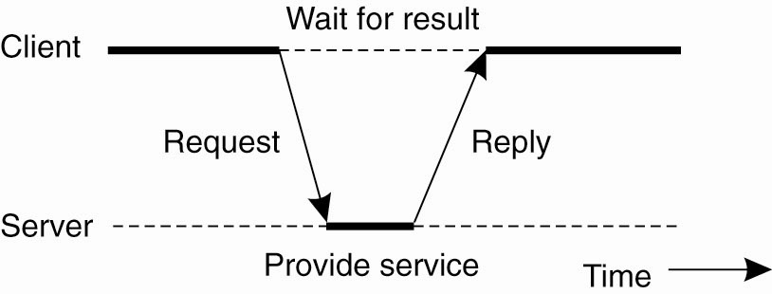
Centralized Architectures
Figure 2-3. General interaction between a client and a server.

Slide 9
Idempotent Operations
Operations that can be repeated multiple times without any harm
Example of Idempotent operation: Getting quotes on a stock or doing a search on the web
Example of none Idempotent operation: Buying stocks

Slide 10
Application Layering (1)
Recall previously mentioned layers of architectural style
The user-interface level
The processing level
The data level

Slide 11
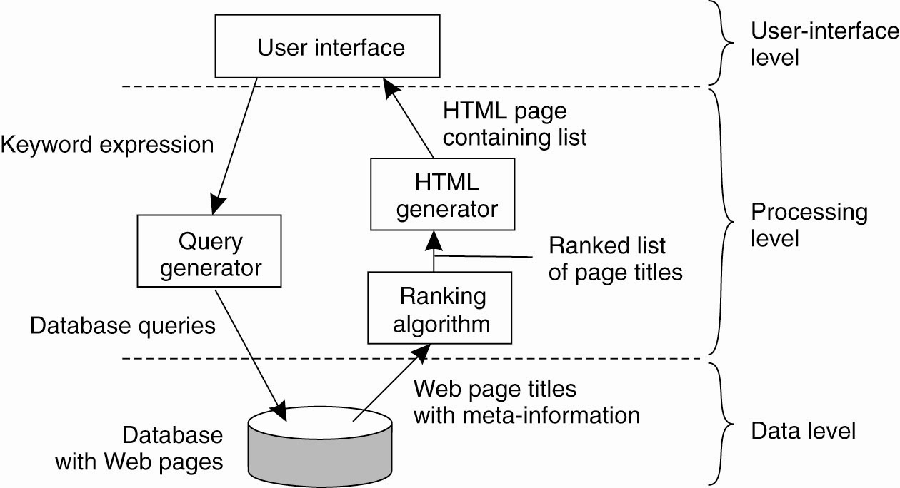
Application Layering (2)
Figure 2-4. The simplified organization of an Internet search engine into three different layers.

Slide 12
Multitiered Architectures (1)
2 Tier Architectures
  Thin Client model
  Fat Client model
3 Tier Architectures
Multitiered Architectures

Slide 13
Multitiered Architectures (2)
(2 Tier Architecture)
The simplest organization is to have only two types of machines:
A client machine containing only the programs implementing (part of) the user-interface level
A server machine containing the rest,
  the programs implementing the processing and data level

Slide 14
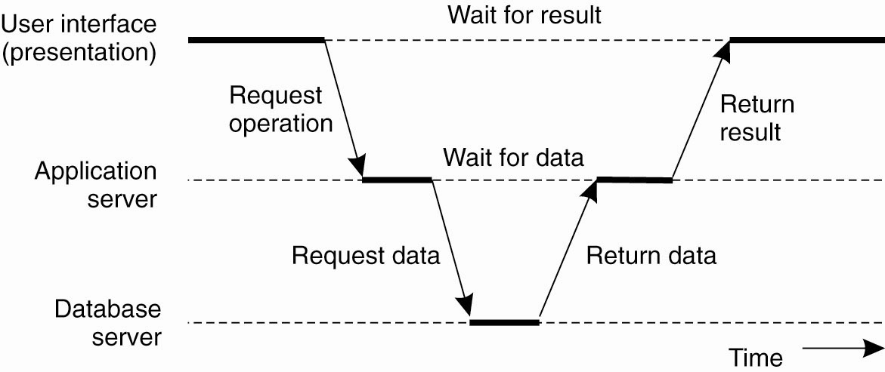
Multitiered Architectures (3)
(3 Tier Architecture)
Figure 2-6. An example of a server acting as client.

Slide 15
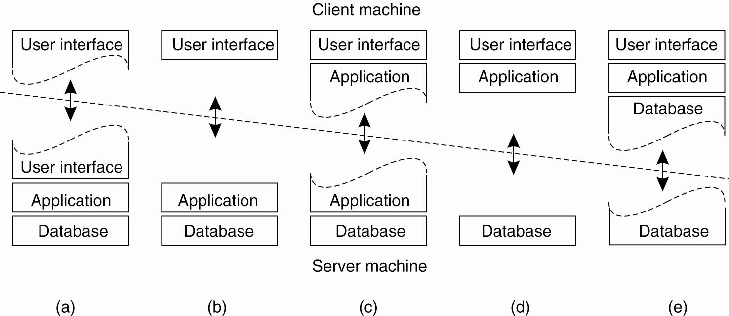
Multitiered Architectures (4)
Thin Client
Fat Client
Figure 2-5. Alternative client-server organizations (a)–(e).

Slide 16
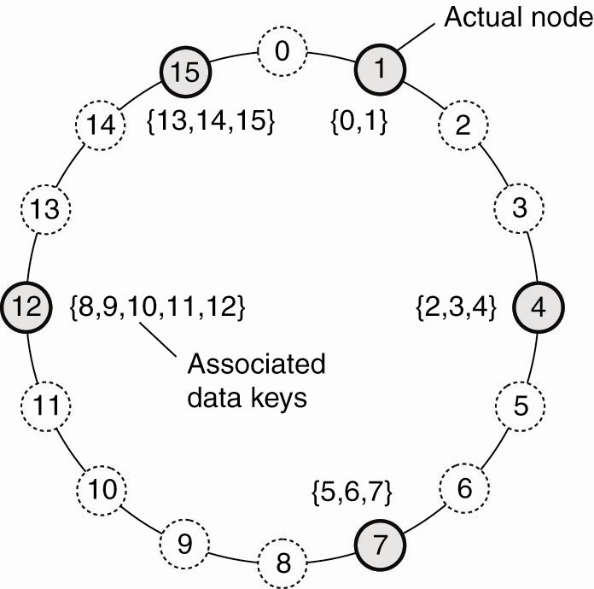
Structured Peer-to-Peer Architectures (1)
Figure 2-7. The mapping of data items onto nodes in Chord.

Slide 17
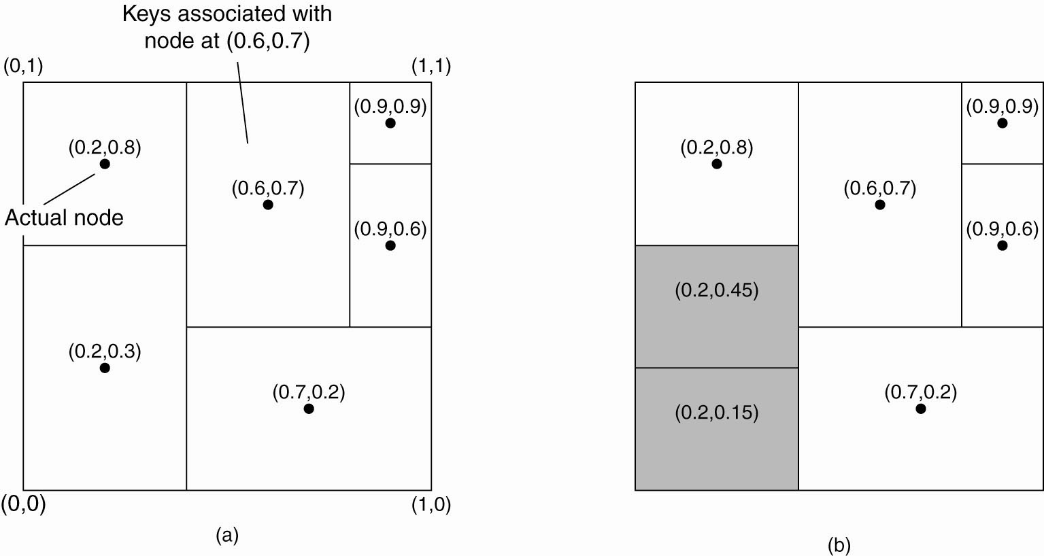
Structured Peer-to-Peer Architectures (2)
2-dim space [0,1] x [0,1] is divided among 6 nodes
Each node has an associated region
Every data item in CAN will be assigned a unique point in space
That node is responsible for that data element.
Figure 2-8. (a) The mapping of data items onto nodes in CAN (Content Addressable Network).

Slide 18
Structured Peer-to-Peer Architectures (3)
To add a new region, split the region
To remove an existing region, neighbor will take over
Figure 2-8. (b) Splitting a region when a node joins.

Slide 19
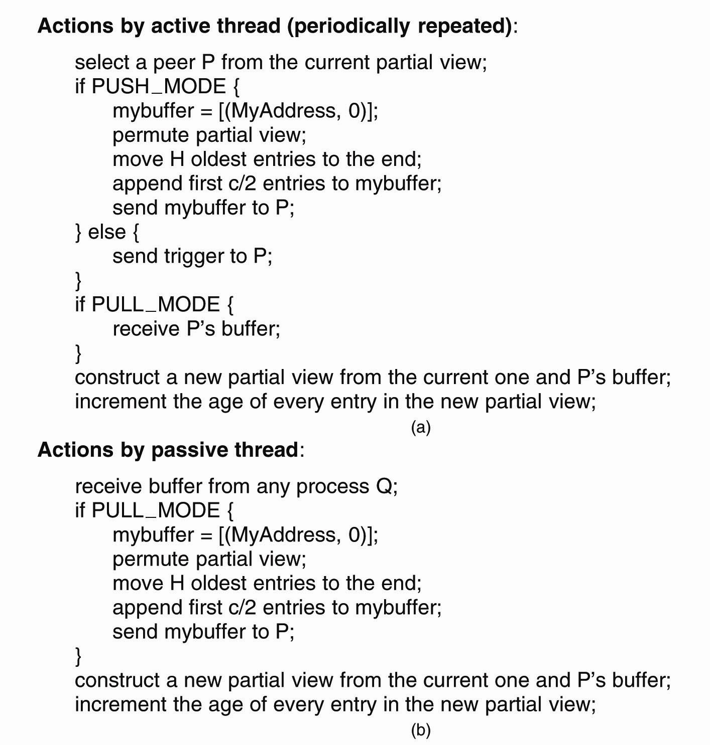
Unstructured Peer-to-Peer Architectures (1)
Figure 2-9. (a) The steps taken by the active thread.

Slide 20
Unstructured Peer-to-Peer Architectures (2)
Figure 2-9. (b) The steps take by the passive thread

Slide 21
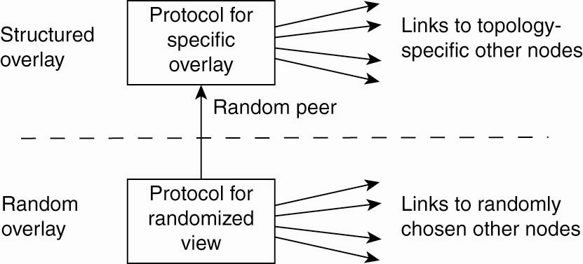
Topology Management of Overlay Networks (1)
Figure 2-10. A two-layered approach for constructing and maintaining specific overlay topologies using techniques from unstructured peer-to-peer systems.

Slide 22
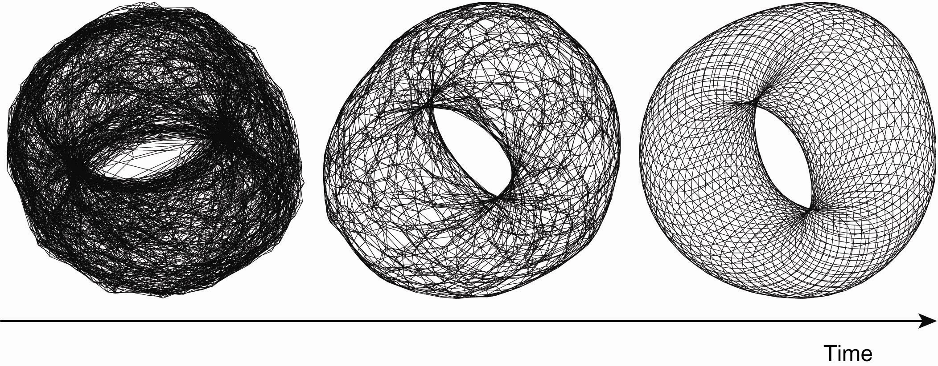
Topology Management of Overlay Networks (2)
Converge toward more accuracy
Figure 2-11. Generating a specific overlay network using a two-layered unstructured peer-to-peer system [adapted with permission from Jelasity and Babaoglu (2005)].

Slide 23
Superpeers (1)
Nodes such as those maintaining an index or acting as a broker are generally referred to as superpeers
Superpeers hold index of information from its associated peers (i.e. selected representative of some of the peers)

Slide 24
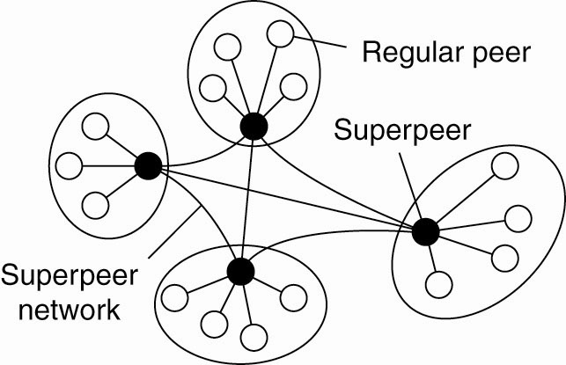
Superpeers (2)
Figure 2-12. A hierarchical organization of nodes into a
superpeer network.

Slide 25
Edge-Server Systems (1)
A hybrid architecture
An idempotent class of distributed systems
Deployed on the Internet where servers are “at the edge” of the network (i.e. first entry to network)
Each client connects to the Internet by means of an edge server

Slide 26
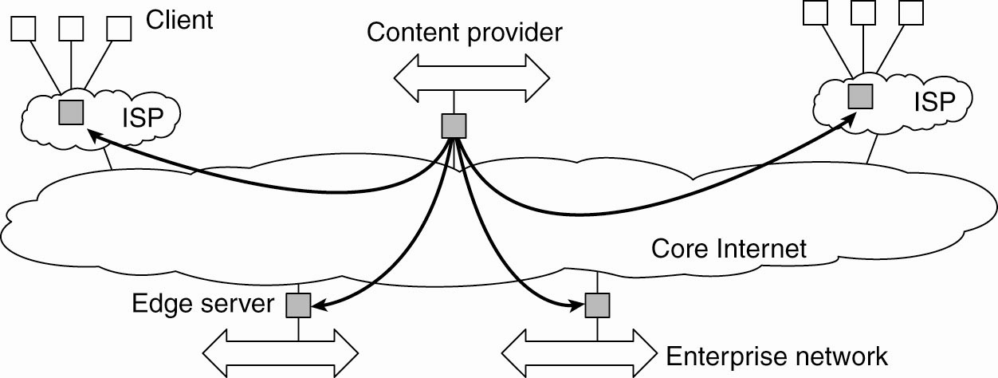
Edge-Server Systems (2)
Figure 2-13. Viewing the Internet as consisting of a
collection of edge servers.

Slide 27
Collaborative Distributed Systems (1)
A hybrid distributed model that is based on mutual collaboration of various systems
Examples of Collaborative Distributed System:
  BitTorrent: is a P2P File downloading system. It allows download of various chunks of a file from other users until the entire file is downloaded
  Globule: A Collaborative content distribution network. It allows replication of web pages by various web servers

Slide 28
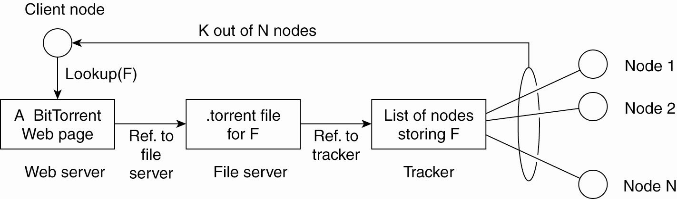
Collaborative Distributed Systems (2)
Many trackers, one per file, tracker holds which node holds which chunk of the file
Information needed to download a specific file
Figure 2-14. The principal working of BitTorrent [adapted with permission from Pouwelse et al. (2004)].

Slide 29
Collaborative Distributed Systems (3)
Components of Globule collaborative content distribution network: (replication of web pages by various users)
A component that can redirect client requests to other servers.
A component for analyzing access patterns.
A component for managing the replication of Web pages.

Slide 30
Collaborative Distributed Systems (4)
Benefits:
Example:
  Alice has a web server; Bob has a web server
  Alice’s server can have replicated contents of the Bob’s server and vice versa
Good if your server goes down
Good if too much traffic that your server can not handle or server gets too slow
Better Geographic diversity
End users voluntarily provide enhanced web servers that are capable of collaborating in the replication of web pages

Slide 31
Interceptors (1)
An Interceptor is a software that breaks the usual flow of control and allows other (application specific) code to be executed
Interceptors are good for providing transparent:
  Replication
  Performance

Slide 32
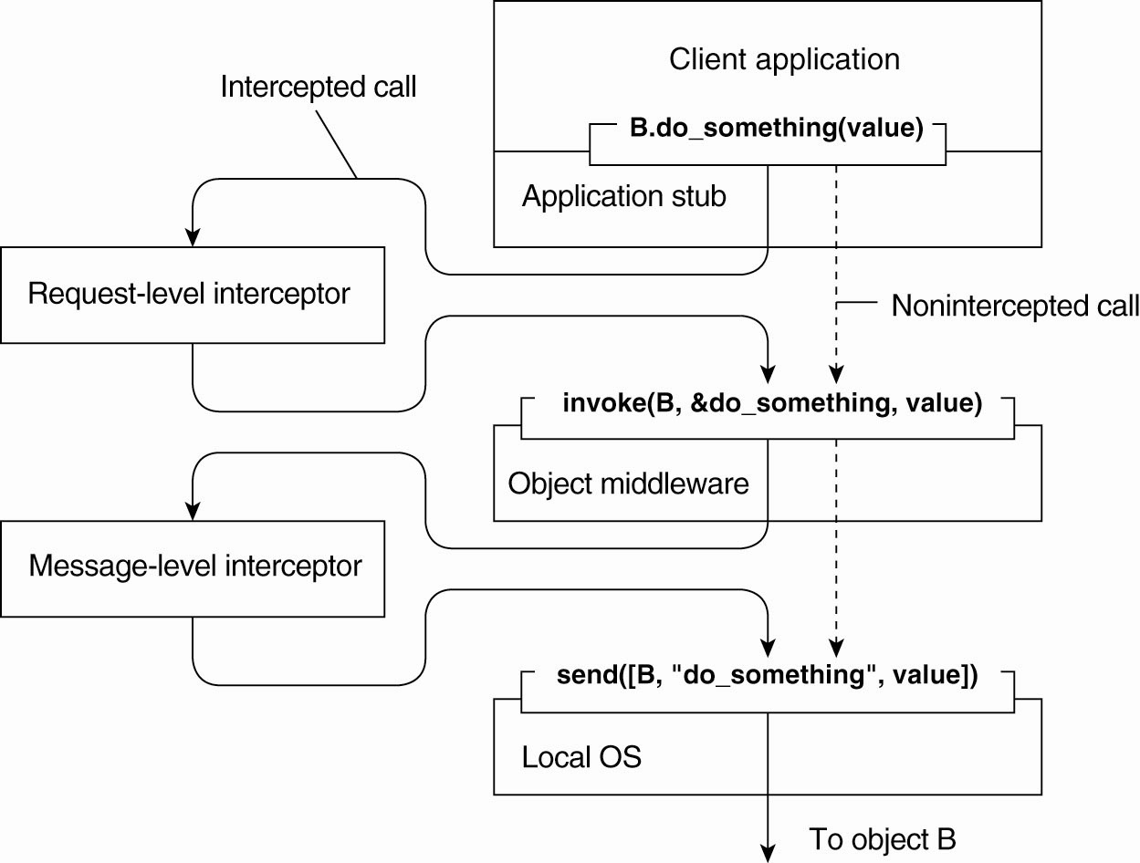
Interceptors (2)
May want to send to many other B’s (i.e. replicated)
May want to break a large message for better performance
Figure 2-15. Using interceptors to handle
remote-object invocations.

Slide 33
General Approaches to Adaptive Software
Three basic approaches to adaptive software (i.e. make adaptation to the environment easier):
Separation of concerns:
  Modularizing the system and separate security from functionality
Computational reflection
  Ability of a program to inspect itself, and if necessary, adapt its behavior
Component-based design (stand-alone)

Slide 34
The Feedback Control System (1)
Self-Management in Distributed systems:
  Shield undesirable features (hacks, garbage, spam)
  Self-Adaptive
  Monitoring and adjustments should be possible
Allowing automatic adaptation to changes (also called “autonomic Computing” or “Self-star systems”)
  Self-managing
  Self-healing (through replication)
  Self-configuring
  Self-Optimizing

Slide 35
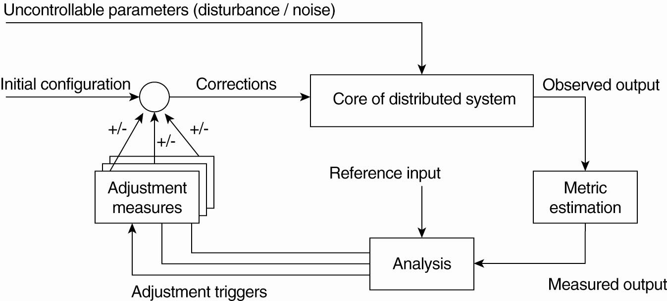
The Feedback Control System (2)
Figure 2-16. The logical organization of a
feedback control system.

Slide 36
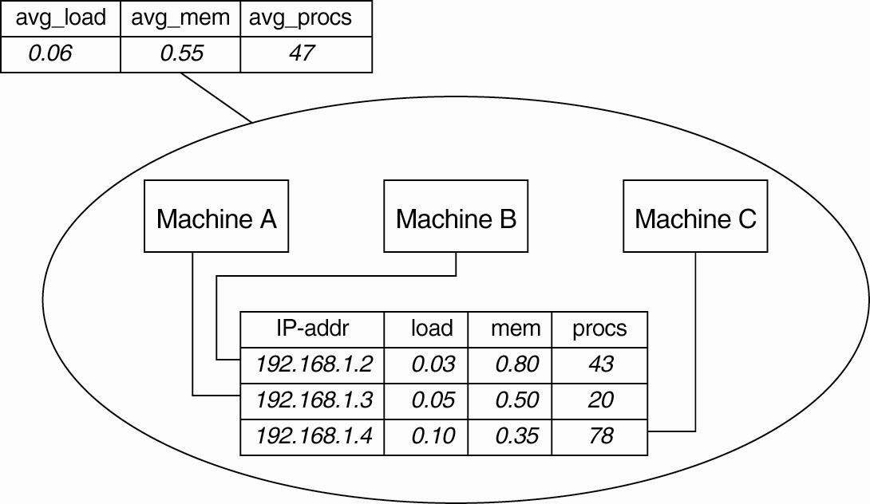
Example: Systems Monitoring with Astrolabe
Figure 2-17. Data collection and information
aggregation in Astrolabe.

Slide 37
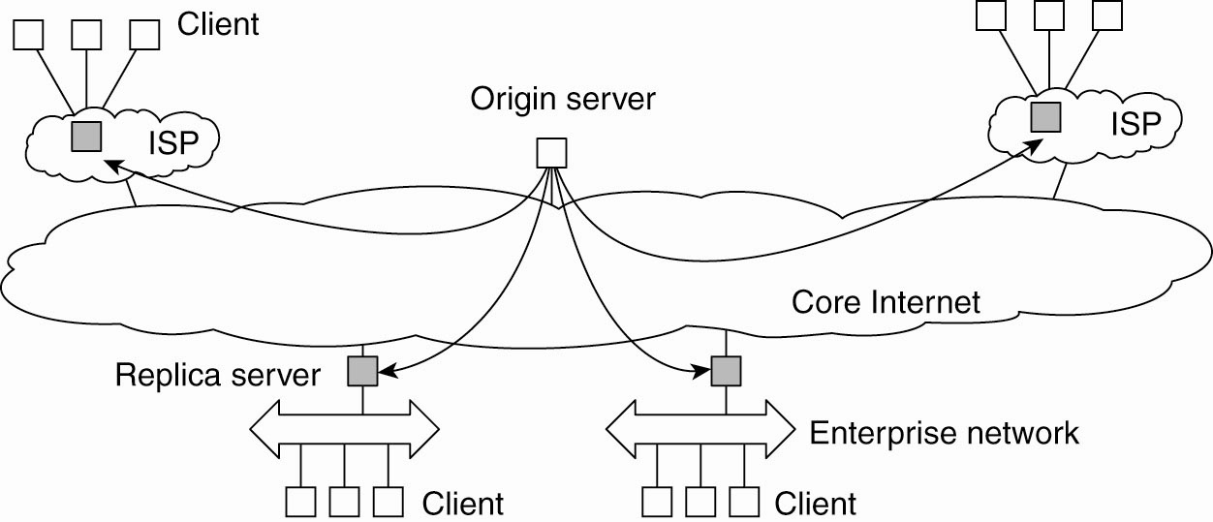
Example: Differentiating Replication Strategies in Globule (1)
Figure 2-18. The edge-server model assumed by Globule.
“Globule: A Collaborative content distribution network”

Slide 38
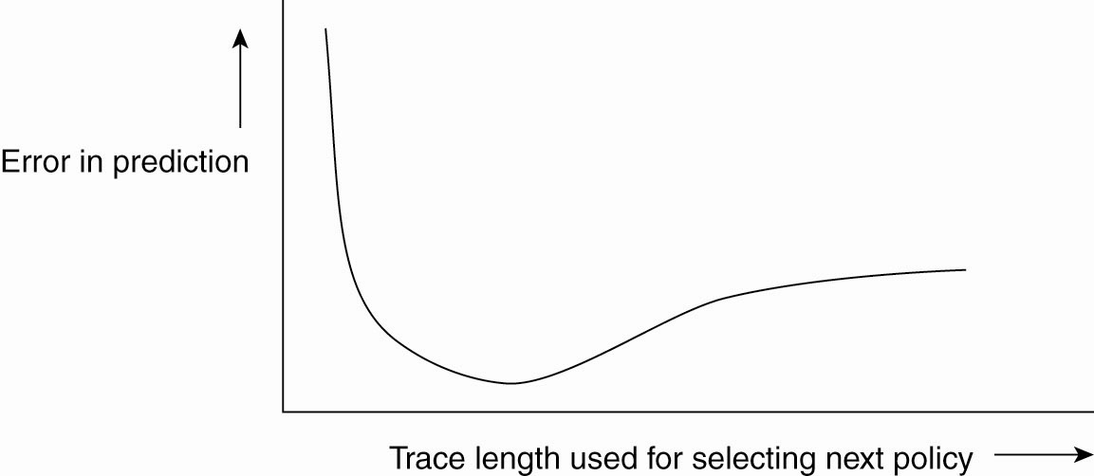
Example: Differentiating Replication Strategies in Globule (2)
Figure 2-19. The dependency between prediction
accuracy and trace length.

Slide 39
Example: Automatic Component Repair Management in Jade
Steps required in a repair procedure:
Jade: A Java implementation framework that allows components to be added and removed at runtime
Terminate every binding between a component on a non-faulty node, and a component on the node that just failed.
Request the node manager to start and add a new node to the domain.
Configure the new node with exactly the same components as those on the crashed node.
Re-establish all the bindings (between client & server interfaces) that were previously terminated.
Done via a repair management server (can be replicated)

